Slide 1
DSC640 Weekly Assignment
Week 5 & 6
Edris Safari

Slide 2
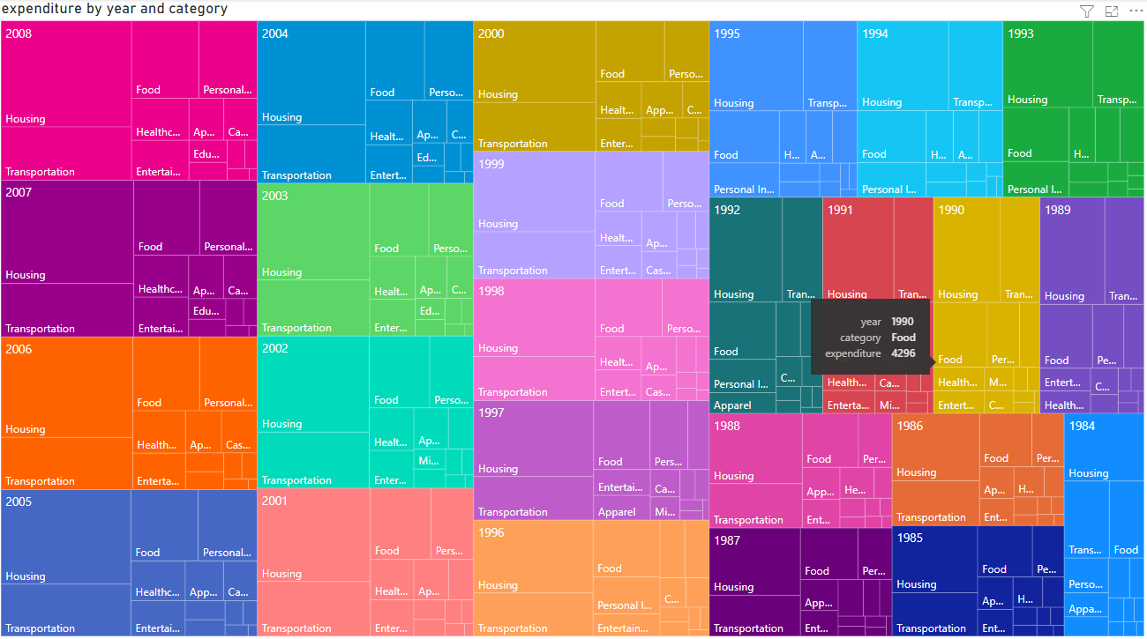
PowerBI Treemap Chart

Slide 3
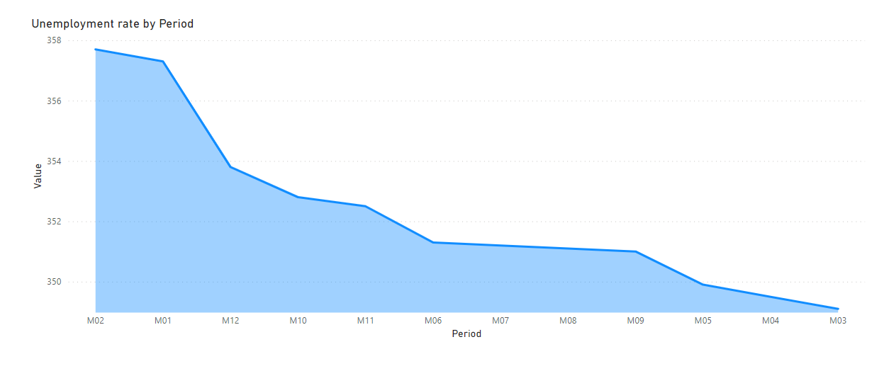
PowerBI Area Chart

Slide 4
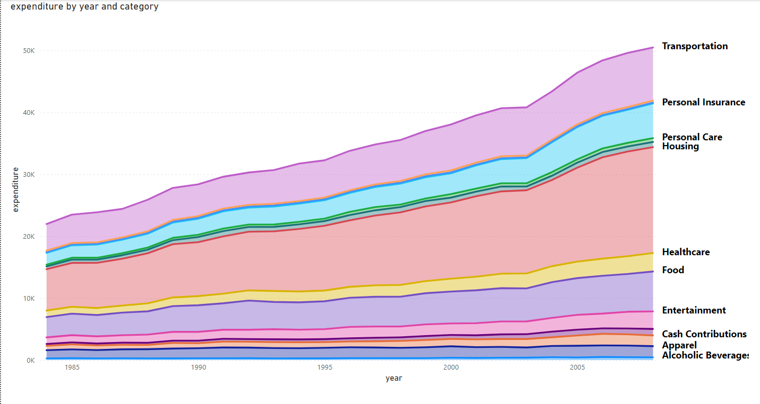
PowerBI Stacked Area Chart

Slide 5
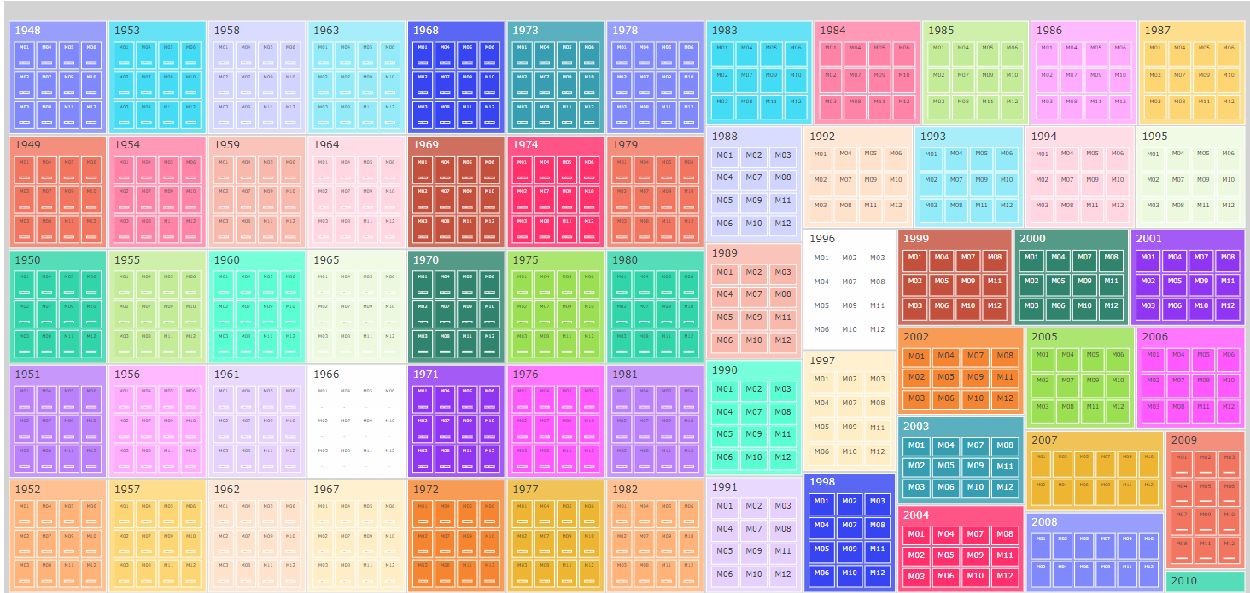
Python Treemap Chart

Slide 6
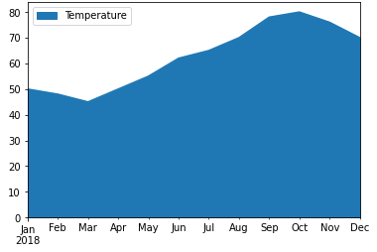
Python Area Chart

Slide 7
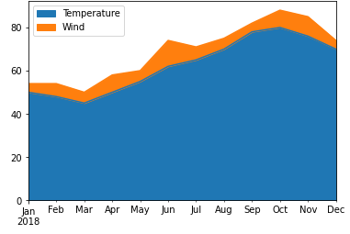
Python Stacked Area Chart

Slide 8
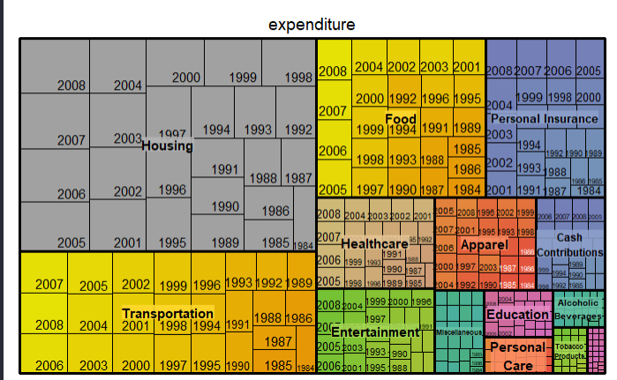
R Treemap Chart

Slide 9
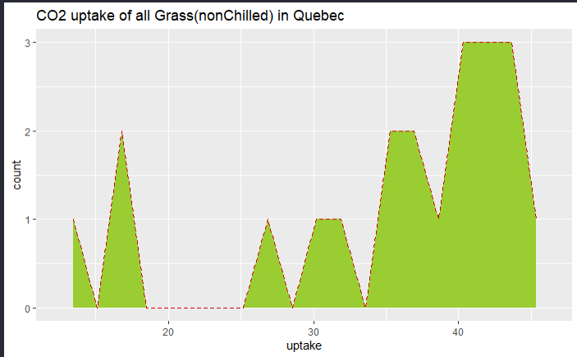
R Area Chart

Slide 10
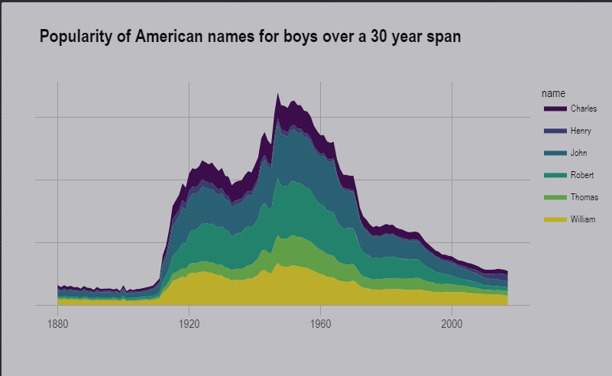
R Stacked Area Chart

